Slide 1
19SSK311 – SESSION 1
SYLLOGISMS
Some actors are singers
All the singers are dancers

Slide 2
FOUR TYPES OF STATEMENTS
All Engineers are smart Universal Affirmative
Some Engineers are smart Particular Affirmative
No Engineers are smart Universal Negative
Some Engineers are not smart Particular Negative

Slide 3
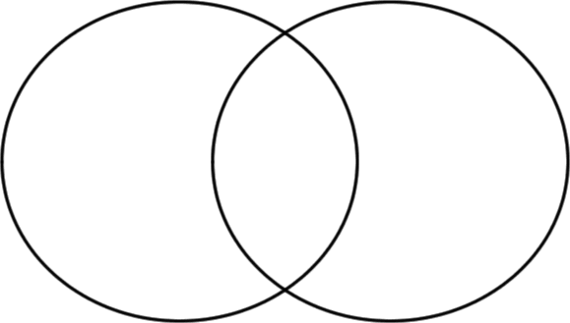
REPRESENTATION THROUGH VENN DIAGRAMS
All Engineers are smart
Some Engineers are smart
No Engineers are smart
Some Engineers are not smart
E
S
E
S

Slide 4
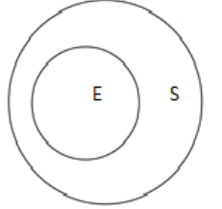
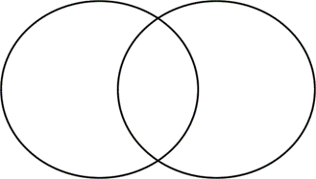
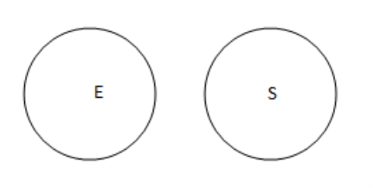
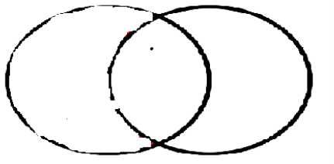
CONVERSE
E
S
E
S
1.All Engineers are smart Some smart are Engineers
2. Some Engineers are smart Some smart are Engineers
3.No Engineers are smart No smart are Engineers
4. Some Engineers are not smart NO VALID CONVERSE

Slide 5
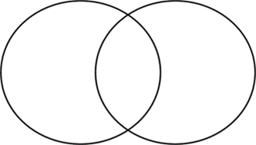
1. All Engineers are smart 3.No Engineers are smart 2. Some Engineers are smart 4. Some Engineers are not smart
E
S
E
S
TYPES OF STATEMENTS | SUBJECT | PREDICATE
1. UNIVERSAL AFFIRMATIVE | √ | X
2. PARTICULAR AFFIRMATIVE | X | X
3. UNIVERSAL NEGATIVE | √ | √
4. PARTICULAR NEGATIVE | X | √

Slide 6
RULE 1: The middle term should be distributed at least once. Otherwise no conclusion
Some papers are pens
All the pencils are pens
Conclusion: Some pens are papers
Some pens are pencils

Slide 7
RULE 2: If both the premises are universal, then the conclusion is universal
All harmoniums are instruments
All the instruments are flutes
Conclusion: All harmoniums are flutes
Converse of Conclusion: Some flutes are harmoniums
Converse of first Premise: Some instruments are harmoniums
Converse of Second Premise: Some flutes are instruments

Slide 8
RULE 3: If both the premises are affirmative then the conclusion is affirmative
All the actors are girls
All the girls are beautiful
Conclusion: All the actors are beautiful
Converse of Conclusion: Some beautiful are actors
Converse of first Premise: Some girls are actors
Converse of second Premise: Some beautiful are girls

Slide 9
RULE 4: If one of the premises is particular then the conclusion is particular
Some ants are parrots
All the parrots are apples
Conclusion: Some ants are apples
Some apples are ants
Some parrots are ants
Some apples are parrots

Slide 10
RULE 5: If one of the premises is negative, then the conclusion is negative
All the windows are doors
No door is a wall
Conclusion: No windows are walls
No walls are windows
Some doors are windows
No wall is a door

Slide 11
RULE 6: If both the premises are particular then no conclusion is possible
Some mangoes are yellow
Some oranges are mangoes
Conclusion: Some yellow are mangoes
Some mangoes are oranges

Slide 12
RULE 7: If both premises are negative then no conclusion is possible
Some carrots are not brinjals
No brinjals are potatoes
Conclusion: No potatoes are brinjals

Slide 13
RULE 8: If the middle term is distributed twice then the conclusion cannot be universal
All women are strong
All women are hardworking
Conclusion: Some strong are hardworking
Some hardworking are strong
Some strong are women
Some hardworking are women

Slide 14
RULE 9: If major premise is particular and minor premise is negative, no conclusion can be drawn.
No sinners are men (minor premise)
Some men are moral (major premise)
Conclusion: No men are sinners
Some moral are men

Slide 15
RULE 10: No term can be distributed in the conclusion if it is not distributed in the premises
All cups are books
√ x
All books are shirts
√ x
Conclusion: All cups are shirts
√ x

